Slide 1

My Steam Accounts Data Analysis
Berk Karaduman 29428

Slide 2

My Data Set

Slide 3
My Hypothesis
My gaming frequency must have decreased due to the intensity of my education life, Souls like and action RPGs have to be my favorite genre.

Slide 5
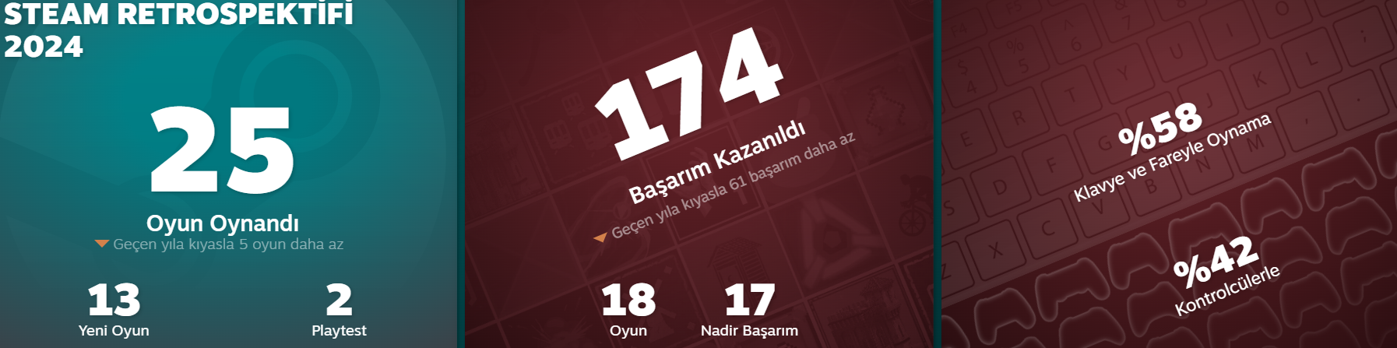
I explored my Steam data, I can convey the data I obtained from my Steam retrospective as follows.
Compared to last year, I played 5 less games and earned 61 less achievements. In addition to this data, 58% of my gaming sessions were with keyboard and mouse, while the rest were with a game controller.

Slide 6
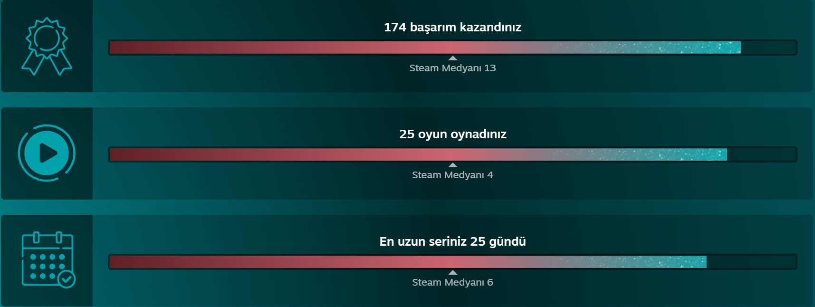
Here, my usage stands out compared to the average usage of general Steam users.
I have earned 174 achievements this year, and I have earned them in 25 games, and the longest I have logged into Steam consecutively is 25 days.

Slide 7
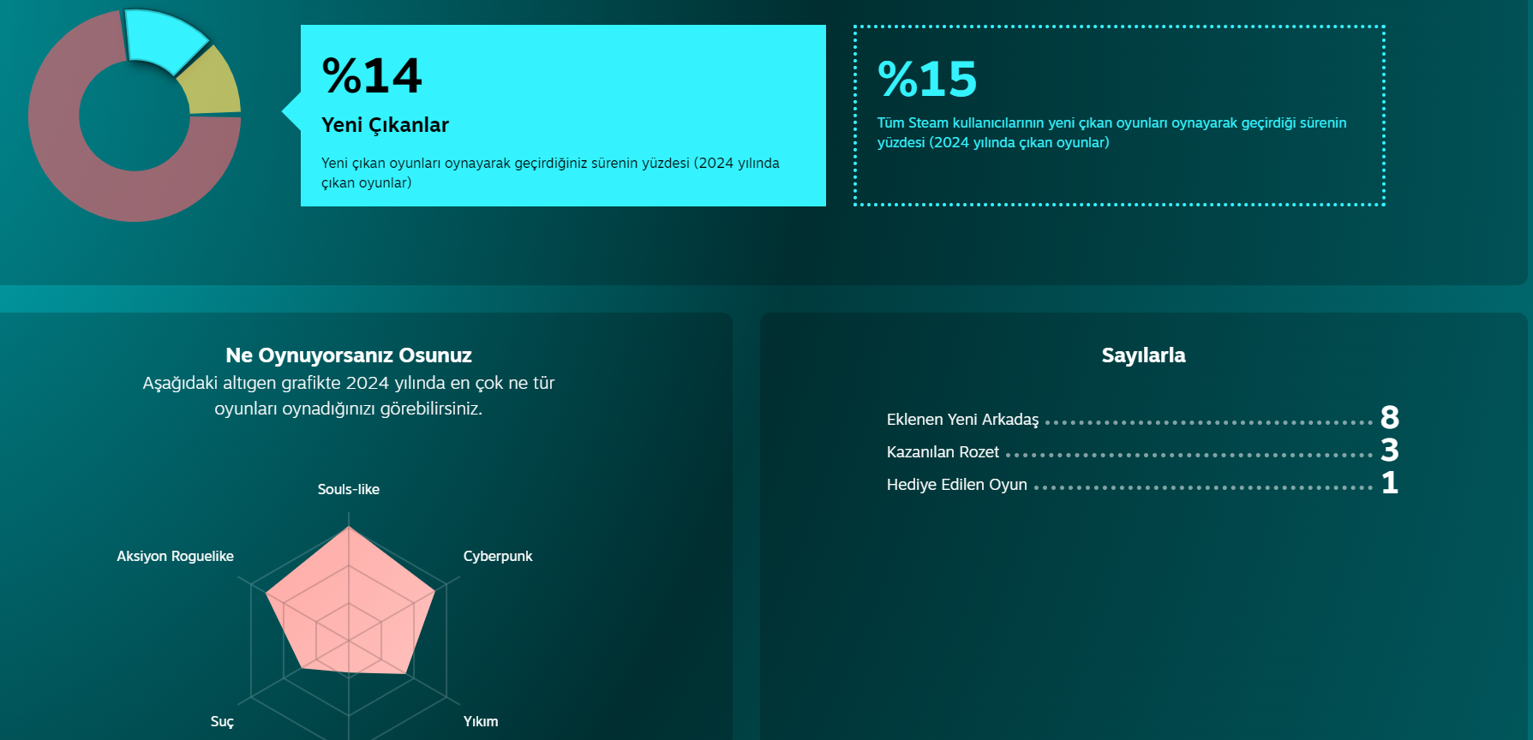
While I play 14% of new games, the average for Steam users is 15%. The game genres I play the most are Souls-like, Action Roguelike and Cyberpunk.

Slide 8
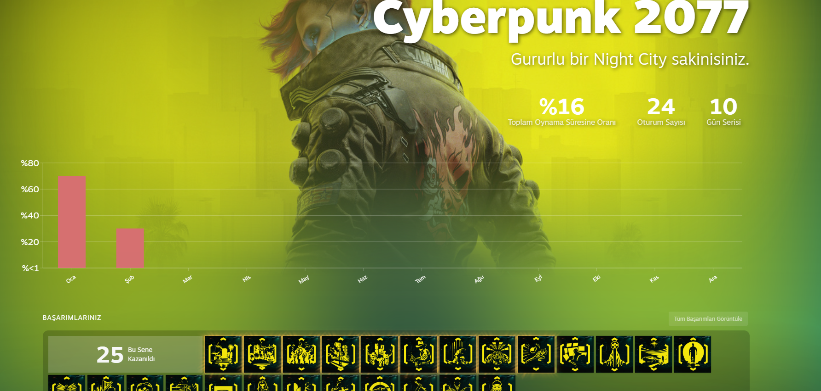
I only played Cyberpunk 2077 in January and February, playing 70% of it in January and 30% in February. I managed to cover 16% of my total play time this year and played the game in 24 sessions and 10 days straight. I got 25 achievements from this game this year.

Slide 9
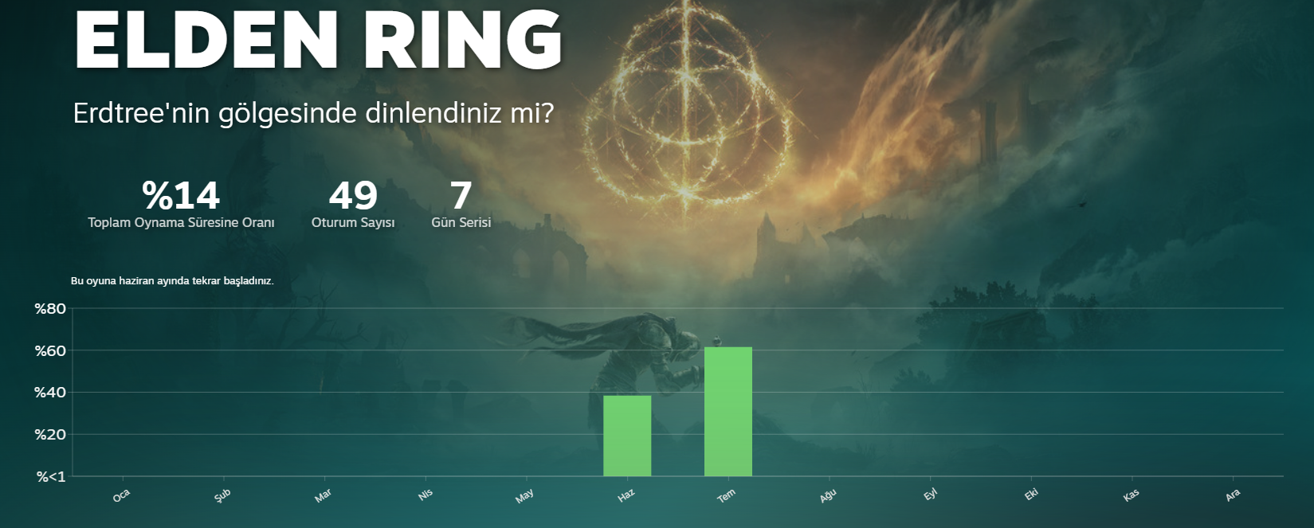
I only played Elden Ring in June and July, playing 38% of it in June and 62% in July. I managed to cover 14% of my total play time this year and played the game in 49 sessions and 7 days straight. I got 0 achievements from this game this year.

Slide 10
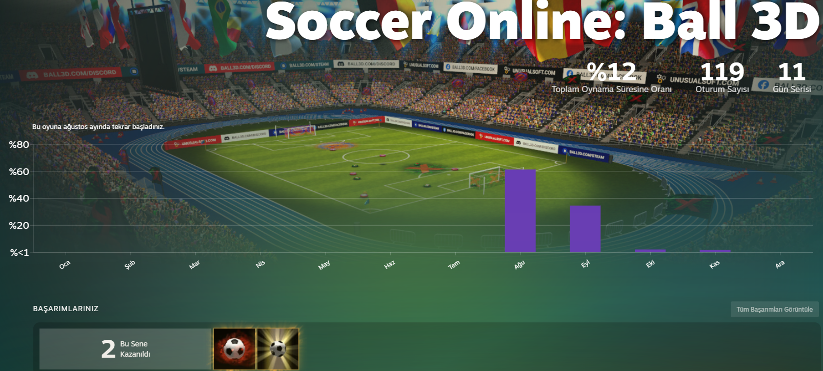
I only played Soccer Online: Ball 3D in August, September, October and November, 61% of the time in August, 35% in September and an equal 2% in October and November. I managed to cover 12% of my total play time this year and played the game in 119 sessions and 11 days straight. I got 2 achievements from this game this year.

Slide 11
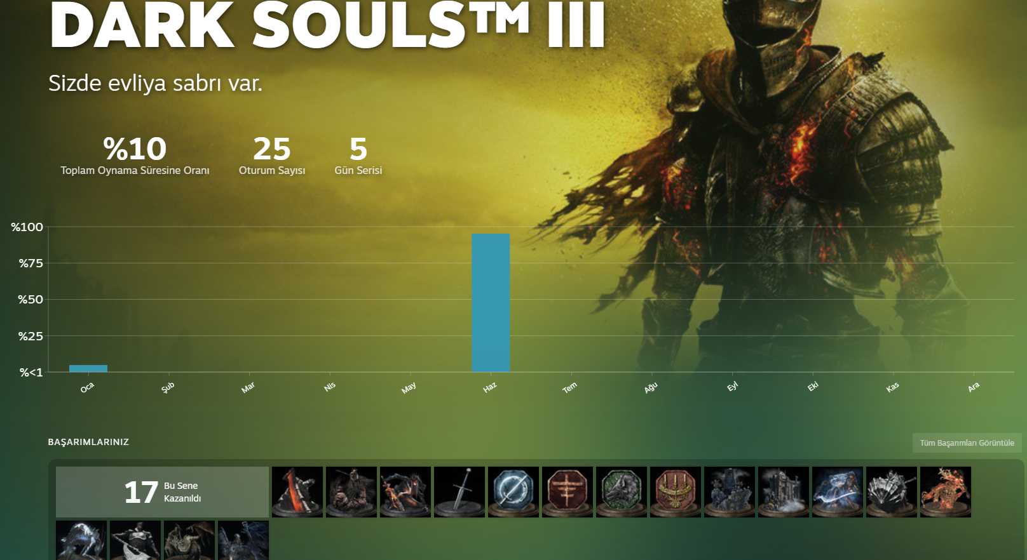
I only played Elden Ring in January and June, playing 5% of it in January and 95% in July. I managed to cover 10% of my total play time this year and played the game in 25 sessions and 5 days straight. I got 17 achievements from this game this year.

Slide 12
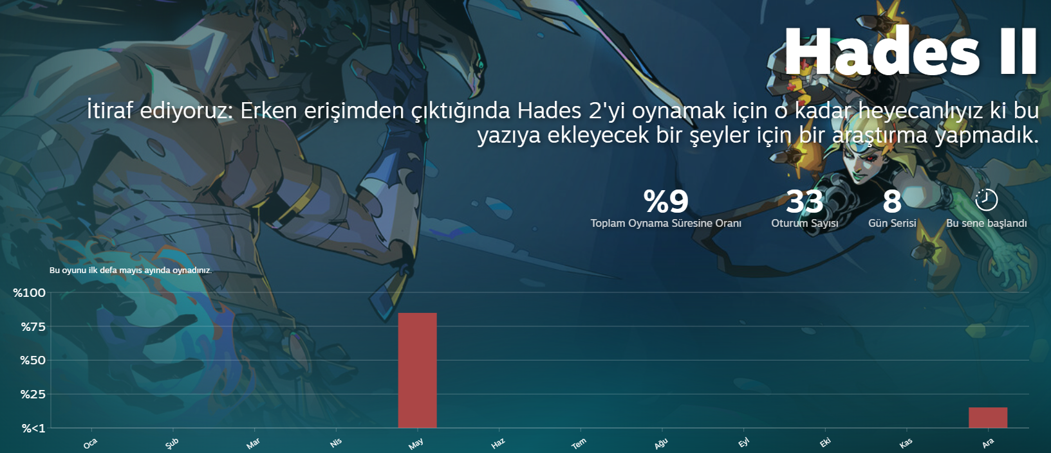
I only played Hades II in May and December, playing 85% of it in May and 95% in December. I managed to cover 9% of my total play time this year and played the game in 33 sessions and 8 days straight. I got 0 achievements from this game this year.

Slide 13
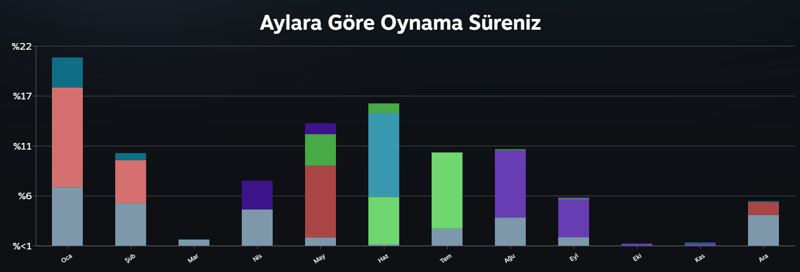
This year's playing percentage divided by month. January is the most prominent with 21%

Slide 14
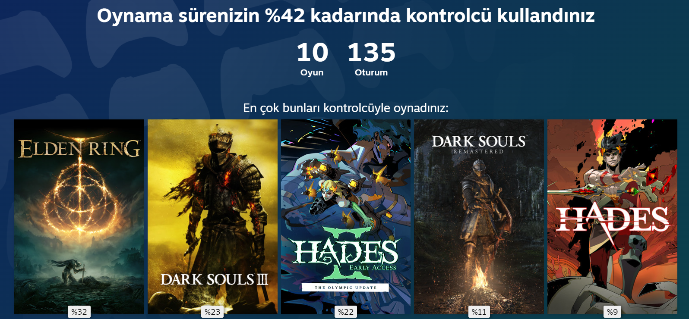
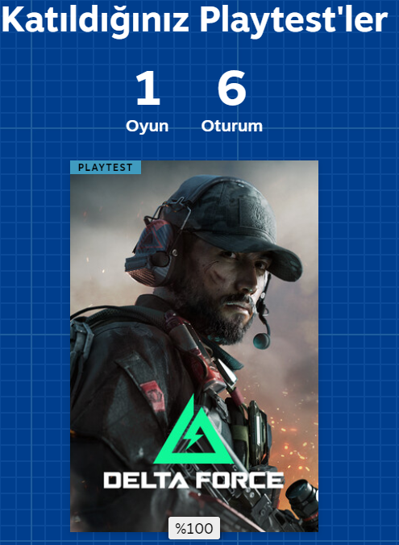
These are the most played games with controller gameplay, which makes up 42% of my total gameplay time. I also participated in 1 playstest this year.

Slide 15
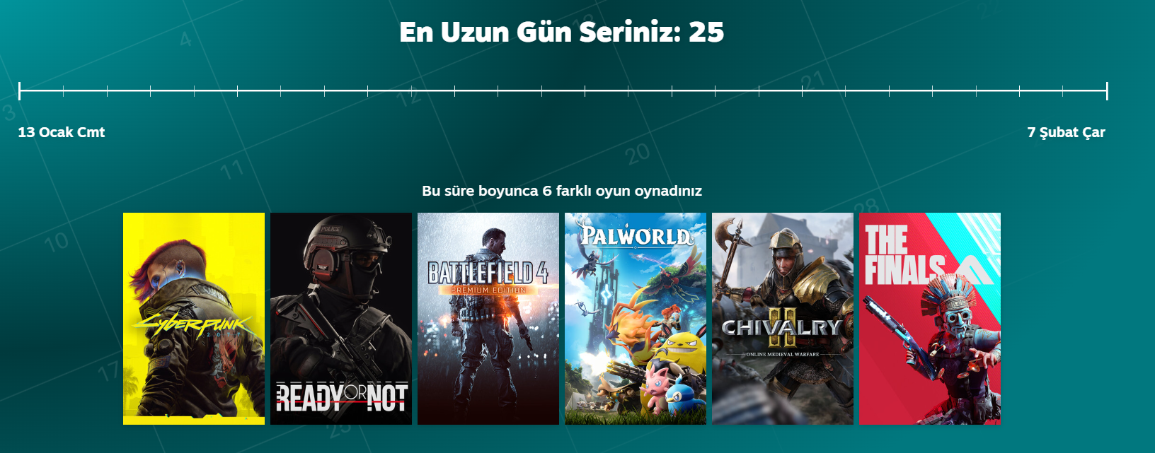
I logged into Steam for 25 days straight from Saturday, January 13th to Wednesday, February 7th. During this time, I played 6 different games.

Slide 16
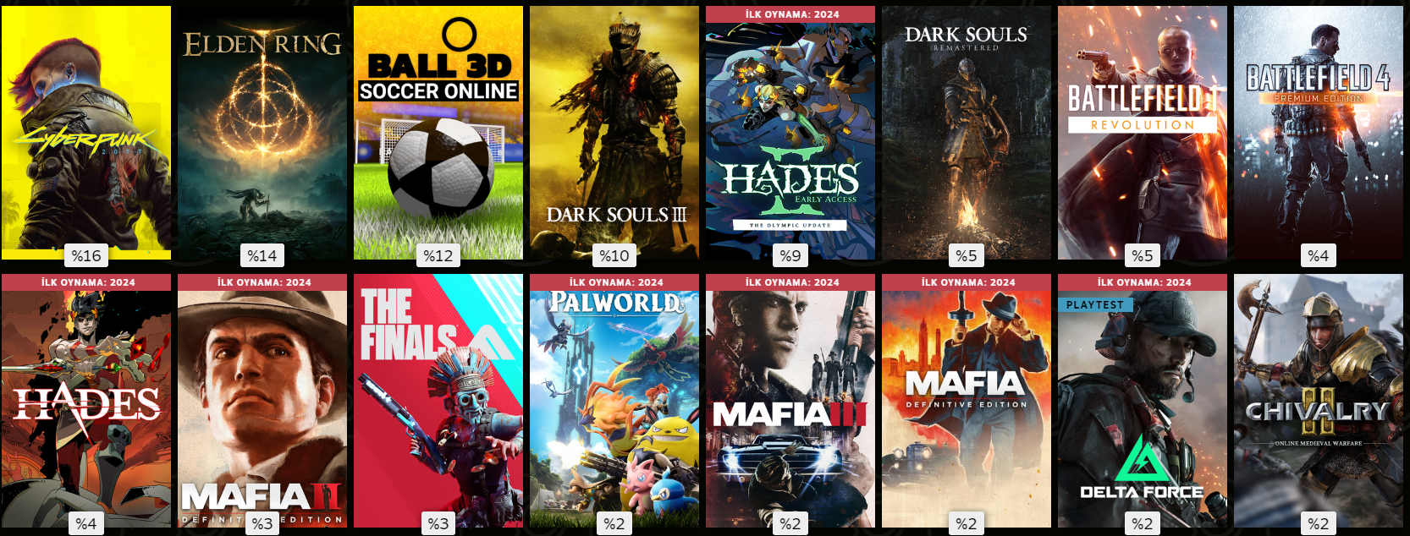

Percentages of games I've played this year compared to the rest

Slide 17
In conclusion I have accepted my Null Hypotesis that:
«When the data is examined, it is seen that even the achievements earned have decreased compared to last year and that the majority of the games played are in the Fantasy RPG genre such as "Elden Ring" and "Dark Souls".

Slide 18
Thank you for your time.

